Slide 1
Whole School, Whole Community, Whole Child
Missouri Coordinated School Health Coalition

Slide 2
About MCSHC
Mission
Ensure students learn to be healthy and are healthy to learn
Vision
Healthy, active students becoming healthy, active and productive adults
Core Values
Health & school health, community health, responsibility, excellence, and flexibility

Slide 3
What we do
Assist schools, families, and communities w/ their coordinated school health programs
Provide educational resources
Services: newsletter, annual conference
Products: program guides, brochures, and flyers
Mental health, healthy eating, physical activity, etc.

Slide 4
Resources
Who can obtain
Free on website
Types of information
Survey data
Demographics
Healthcare access utilization
Reproductive health
Smoking/tobacco use

Slide 5
Partners
Missouri Foundation for Health
American Cancer Society-Heartland Division
Family and Community Trust
Boone County Health Department
Parents as Teachers National Center, Inc.
Many more!

Slide 6
Model Shift
1987 Coordinated School Health (CSH) approach
Integrated health-promotion practices in school setting
Helped establish policies in states, districts, and schools

Slide 7
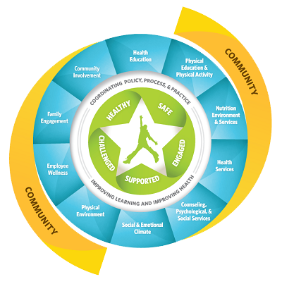
Model Shift Continued
WSCC expands and updates
CSH
ASCD’s whole child approach
Attention put on the child
School-wide approach
Learning, health, and school are a part and reflection of the local community

Slide 8
Model Component 1
1. Health Education
Formal and structured
Planned learning experiences
Acquire information and skills needed to make quality health decisions
Knowledge, attitude, and skills

Slide 9
Model Component 2
Nutrition Environment and Services
Learn and practice healthy eating
Available foods and beverages
Nutrition education
Messages in cafeteria and throughout campus

Slide 10
Model Component 3
Employee Wellness
Protect school staff
foster employee physical and mental health
Helps support students’ health and academic success
Employees: teachers, administrators, bus drivers, cafeteria & custodial staff, and contractors
Create an environment that supports healthy behaviors

Slide 11
Model Component 4
Social and Emotional School Climate
Psychosocial aspects of students’ educational experience
Influences students’ social and emotional development
Impacts
Engagement in school activities
Relationships with other students, staff, family, and community

Slide 12
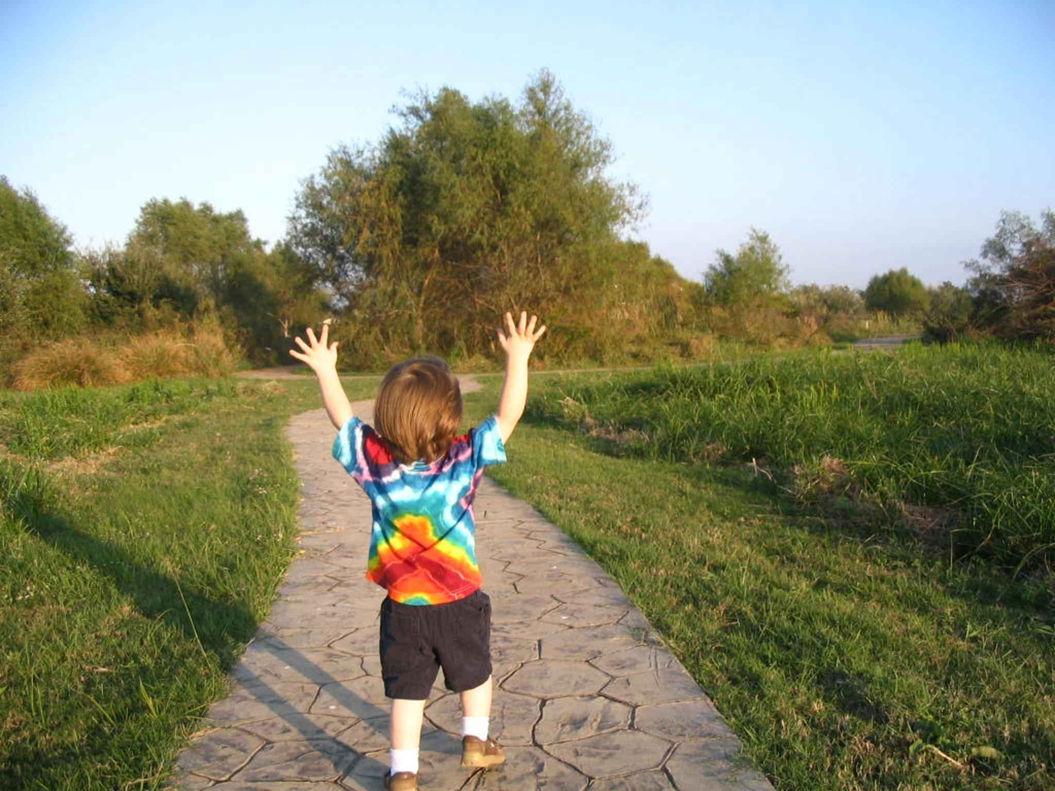
Model Component 5
Physical Environment
Needs to be healthy and safe
Promotes learning
Encompasses
school building and its contents
Land school is on
Area surrounding school/land

Slide 13
Model Component 6
Health Services
Intervene with actual and potential health problems
First aid, emergency care, assessment, and planning
Wellness promotion, prevention services

Slide 14
Model Component 7
Counseling, Psychological, and Social Services
Prevention and intervention
Support mental, behavioral, and social-emotional healthy
Promote success in the learning process
Services
Assessments, interventions, and referrals

Slide 15
Model Component 8
Community Involvement
Community groups, organizations, and local business
Create partnerships with schools
Share resources
Volunteer to support learning, development, and activities

Slide 16
Model Component 9
Family Engagement
Families and school staff work together
School staff
Make families feel welcomes, engage families, and sustain family engagement
Families
Actively support child’s learning and development

Slide 17
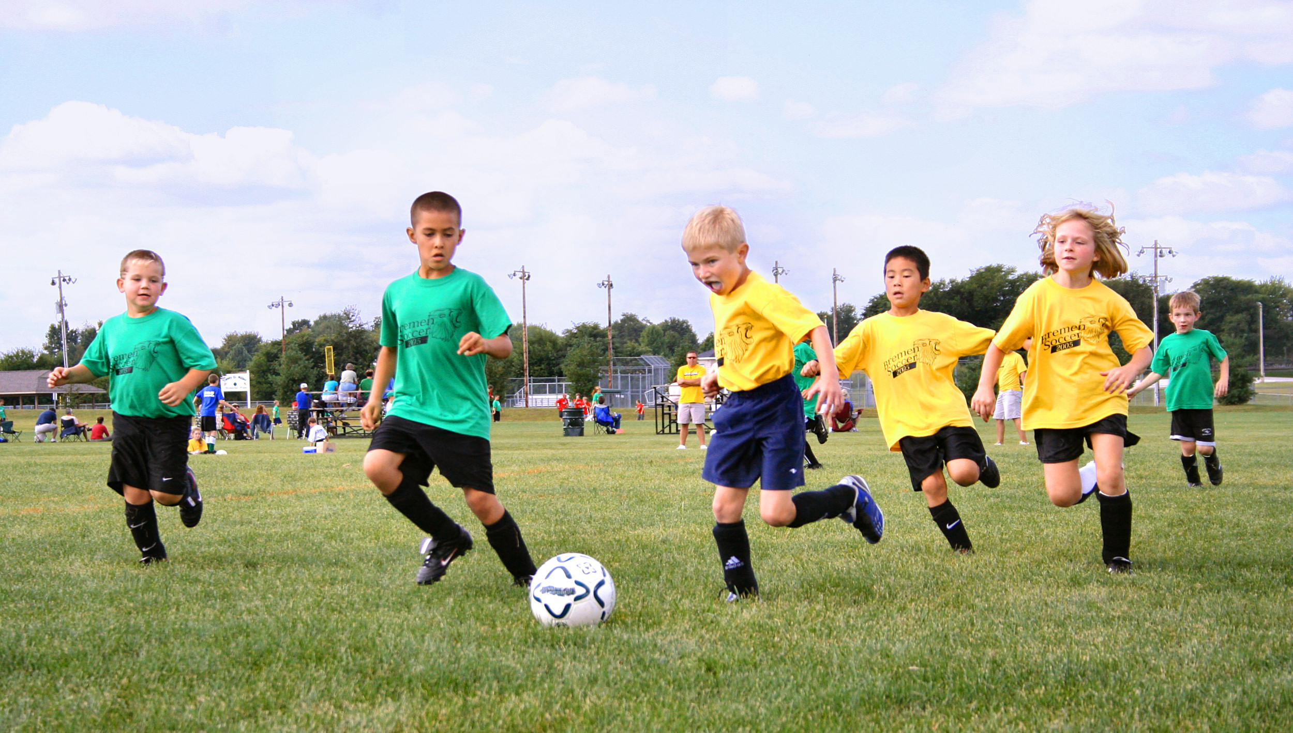
Model Component 10
Physical Education and Physical Activity
Schools create an environment with opportunities
Students can be physically active throughout the day
Comprehensive School Physical Activity Program (CSPAP)
Physical education
Physical activity during, before, and after school
Staff involvement
Family and community engagement

Slide 18
Thank you!
Questions?

